Slide 1





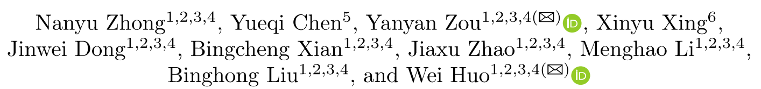
TGRop: Top Gun of Return-Oriented Programming Automation
Notes:
Hello everyone, I am Nanyu Zhong, a PhD student from the Institute of Information Engineering, Chinese Academy of Sciences. I will share our latest research on an old topic, ROP Automation.

Slide 2

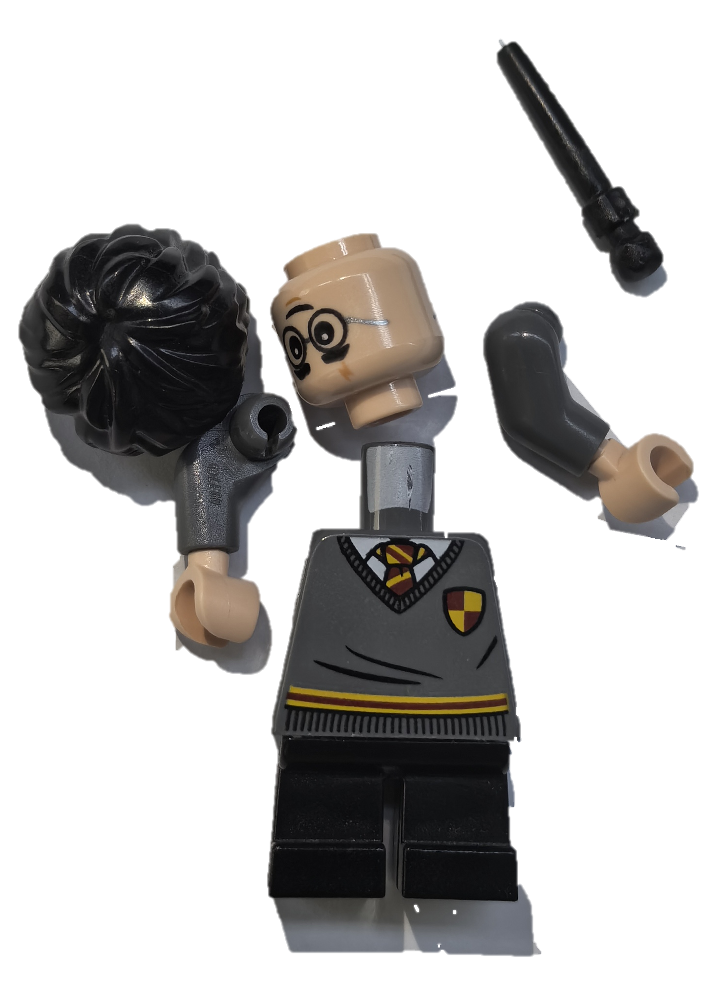



Return-Oriented Programming (ROP) —— What? When? How?
a
pop rax
pop rdi
ret
…
ret
e
b
c
…
jmp xxx
Gadgets
From programs, libc,…
A few instructions
End with ret/jmp/call/…
f
call rax
ret
d
Control Flow Graph (CFG)
Chain Gadgets to call any function!
Buffer Overflow
Heap Overflow
Use After Free
…
a
pop rax
pop rdi
ret
a
b
c
Control Flow Hijack
e
d
b
c
ROP Time!
call rax
ret
f
d
Magic!
Exploitation Base on ROP
Notes:
First, let's review the ROP of what when and how.
In binary programs, any instruction fragment that ends likes ret, jmp, or call can form a "Gadget". These Gadgets are like Lego bricks.
ROP is a code-reuse technique, and it can exploit vulnerabilities at any point during control flow hijacking.
we can chain gadgets to call any function.
Similar to building with Legos. ROP execute After hijacking the control flow to get a shell. This is like assembling a Lego figure of Harry Potter, casting a "spell" on our vulnerability!

Slide 3
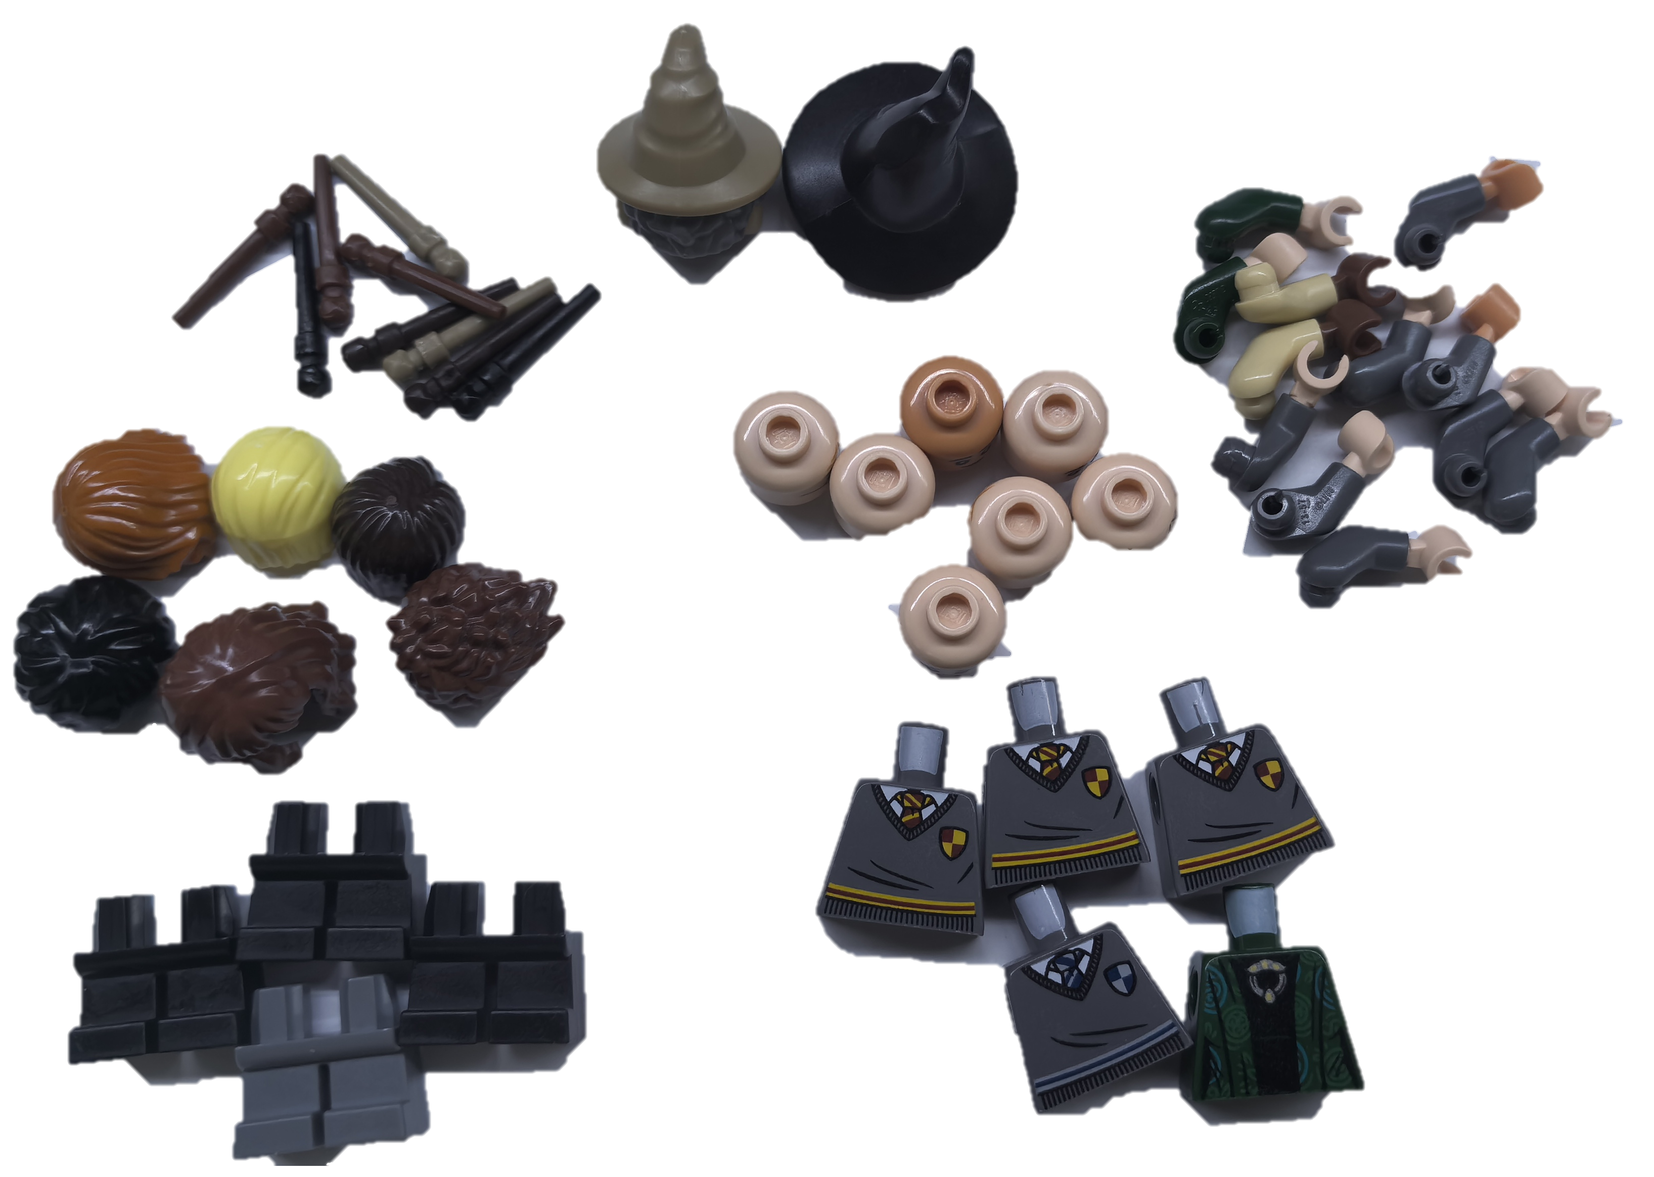


An Interesting Metaphors Of ROP
Gadgets Classification
Some Gadget Chains
One ROP To Call Function
One LEGO Figures Match ROP Tasks: Memory-write, Memory-read or Call any Function!
Notes:
Here is an Interesting Metaphors Of ROP.
Before building with Legos, we sort the bricks, similar to Gadgets Classification.
Assembling Legos is like chaining Gadgets together.
A completed Lego figure represents a constructed ROP, capable of executing a function call.
Different Lego figures symbolize different ROP exploit effects, such as Memory-write, Memory-read or Call any Function!

Slide 4
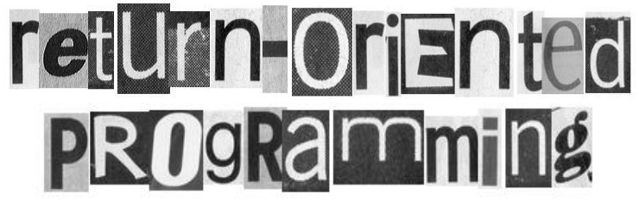





The Past and Present of Return-Oriented Programming Automation
USENIX 2011
Edward J. Schwartz's Initial Proposal of Automated ROP Exploitation!
Open-Source Tool：AngRop、Exrop、Ropium
CCS 20，Esorics 21：
Limbo、SGC
CCS 2007
Hovav Shacham‘s First Time Proposal of ROP Attacks!
？
Heuristic-Based Automation
Exploratory-Based Automation
Manual ROP
Notes:
ROP attack techniques were first introduced in 2007, and since then, many studies have focused on ROP.

Slide 5
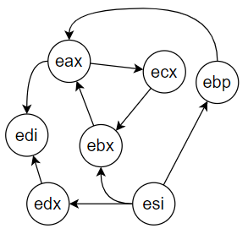
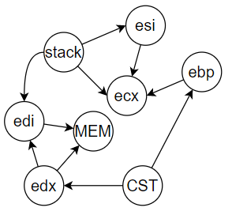
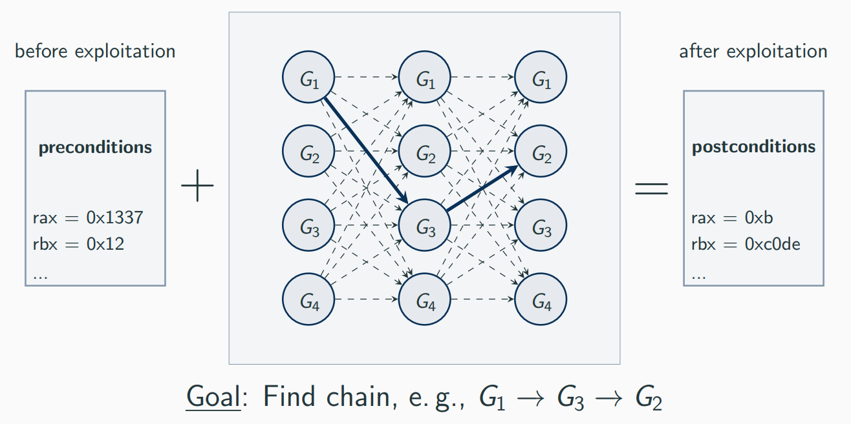
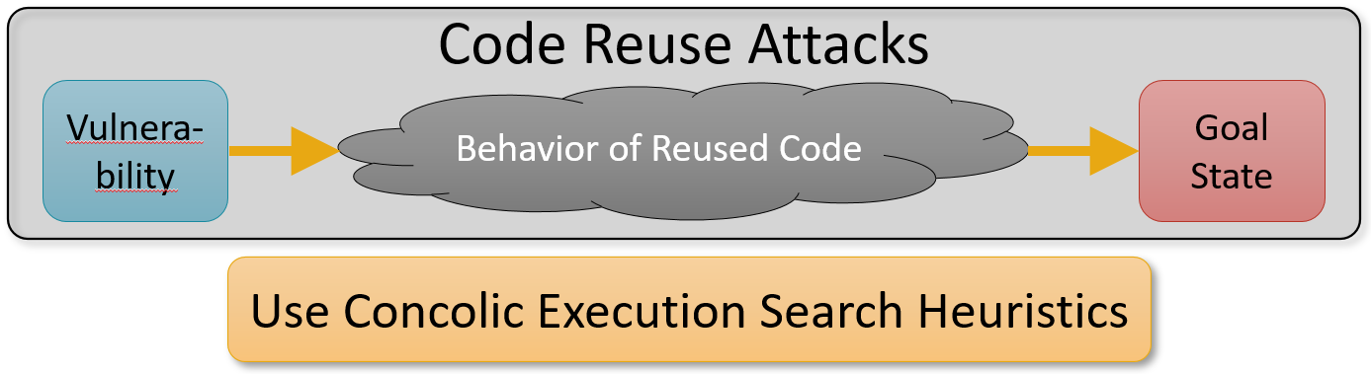
The Past and Present of Return-Oriented Programming Automation
Gadgets Classification Based On semantic
Jump Gadget
Call Gadget
Move REG Gadget
Load MEMORY Gadget
Write MEMORY Gadget
…
Heuristic-Based Automation
Chain through MOV-connection Graph or Rules
Exploratory-Based Automation
Exploring Chains Based on Concolic Execution OR SAT/SMT Solver
Notes:
Heuristic-based automation tools construct ROPs by classifying Gadgets, applying combining rules to generate graphs, and using graph search techniques to heuristically complete the ROP construction.
On the other hand, Exploratory-Based tools use Concolic execution or SMT solvers to explore Gadget chaining paths from the start to the end state.

Slide 6
After 15 Years: Why Are We Even Talking About This?
Why Are We Even Talking About This ?
USENIX 2011
Edward J. Schwartz's Initial Proposal of Automated ROP Exploitation!
Open-Source Tool：AngRop、Exrop、Ropium
CCS 20，Esorics 21：
Limbo、SGC
CCS 2007
Hovav Shacham‘s First Time Proposal of ROP Attacks!
？
Heuristic-Based Automation
Exploratory-Based Automation
Manual ROP
Notes:
So, Why Are We Even Talking About This ?

Slide 7
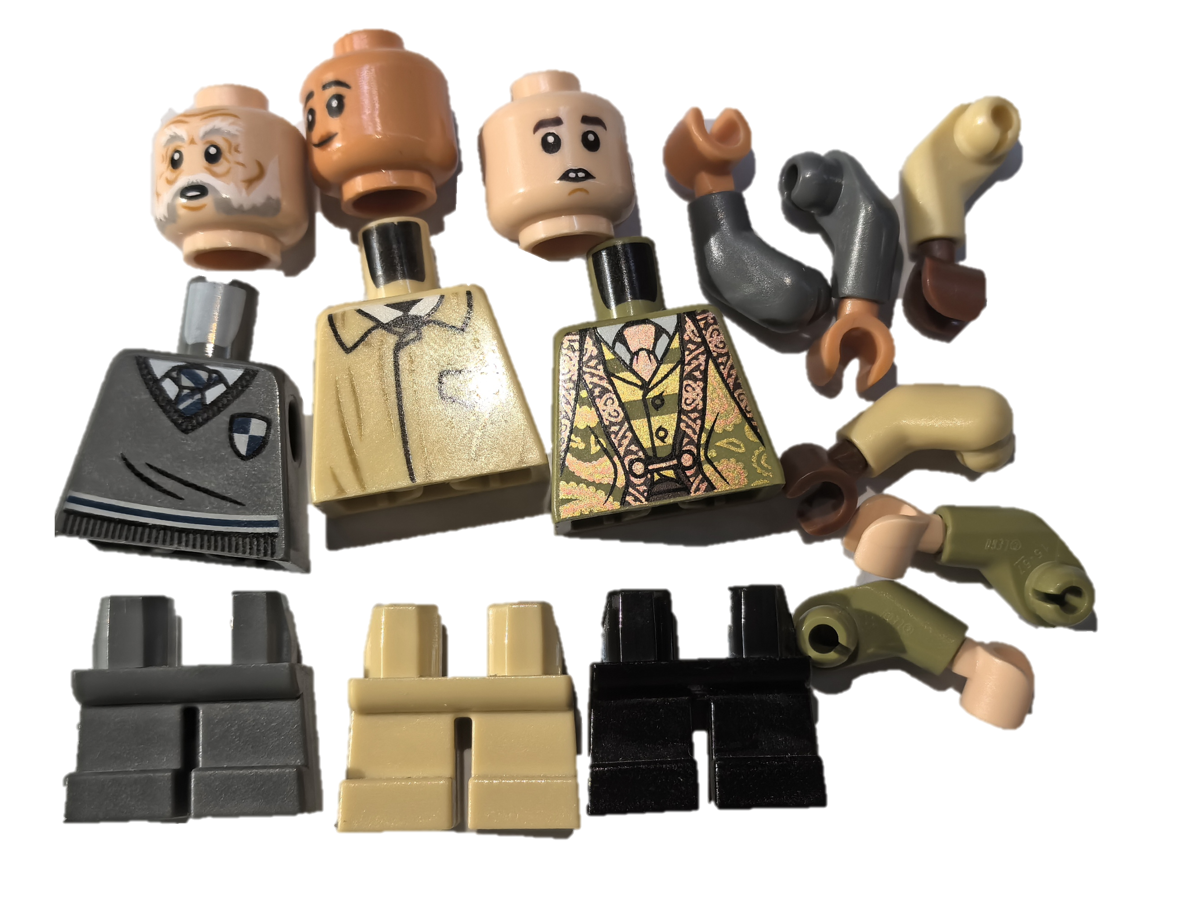

After 15 Years: Why Are We Even Talking About This?
Simple Gadgets
Single ROP Exploit
Heuristic-Based Automation
Complex Gadgets
Diverse ROP Exploits
Notes:
We all know that Gadgets can be simple or complex. Using simple Gadgets to assemble can produce ROP exploits with relatively single functions.
However, if we can chain complex Gadgets, we can achieve ROP exploits with more diverse functionalities.

Slide 8


After 15 Years: Why Are We Even Talking About This?
Discard Partials, Not Seeking All Gadget Combinations
Gadgets Classification Based On semantic
Jump Gadget
Call Gadget
Move REG Gadget
Load MEMORY Gadget
Write MEMORY Gadget
…
Gadgets with Complex Semantics
With memory read/write
With conditional branch
With intricate arithmetic
…
Discard Complex Gadgets → Can’t Create Magic!
add qword ptr [rdi], r8; xor rdx, rdx; jmp rsi;
Heuristic-Based Automation
pop rsi; cmp rdx, 3; xor rdi, rdi; jnz rcx;
sub rdx, r8; sar r8, 63; ret;
Chain through MOV-connection Graph or Rules
Exploration is SL.OW...
Exploratory-Based Automation
Concolic Execution And SMT Solver
Turn Slow…
More Gadgets?
Exploring Chains Based on Concolic Execution OR SMT Solver
Notes:
The problem with current heuristic approaches is that they discard complex Gadgets, losing the ability to 'cast spells'!
On the other hand, as the number of Gadgets increases, exploratory methods slow down due to technological limitations.

Slide 9
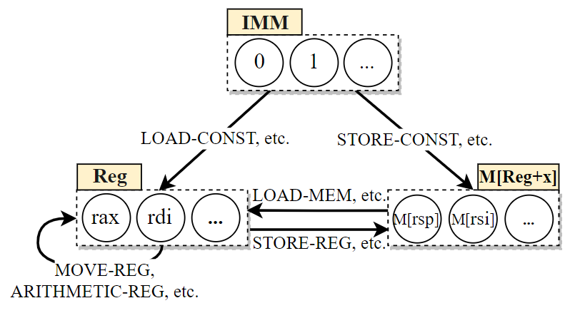
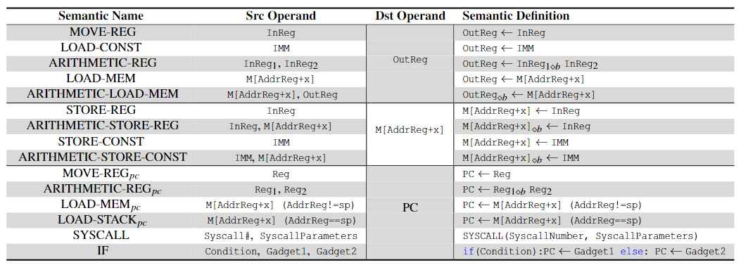
Our Goals --- Find All Gadget Combinations Using Heuristic-Based Method
TGRop – Try to put all gadgets to graph
Considering Complex Gadgets
Gadget Computation Graph (GCG)
① Gadget Classification,
Including Complex Gadgets.
② Building GCG Based on All Gadgets
Node: operands; Edge: Data-Flow direction
Notes:
Therefore, our goal is to put all gadgets onto a graph. This should consider Complex gadgets when doing this, we will encounter some troubles.

Slide 10
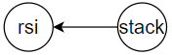
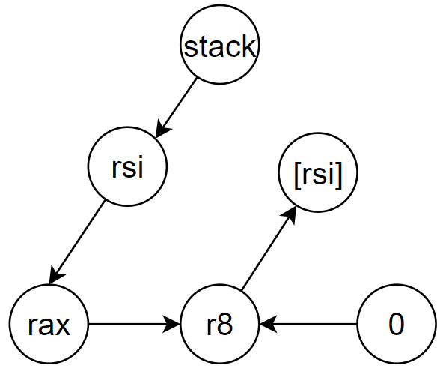
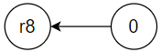
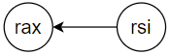
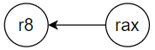
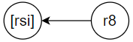
Our Goals --- Find All Gadget Combinations Using Heuristic-Based Method
Motivation Example：Set R8 = 3
① pop rsi; ret;
② xor r8d, r8d; ret;
①
③ mov rax, rsi; ret;
③
④
④ add r8, rax;
mov qword ptr [rsi], r8; ret;
④
②
① Fully Defining Gadget Semantics, Including Complex Gadgets.
② Building GCG Based on All Gadgets
Node: operands; Edge: Data-Flow
Traverse GCG To Get All Gadget Combination!
Notes:
Here is a Motivation example to demonstrate the problems we might encounter.
Suppose we need to set R8 to 3.
After completing the Gadgets classification and Building the GCG.
We search the gadget combinations by traversing the GCG, starting from the stack and R8 as the endpoint.

Slide 11
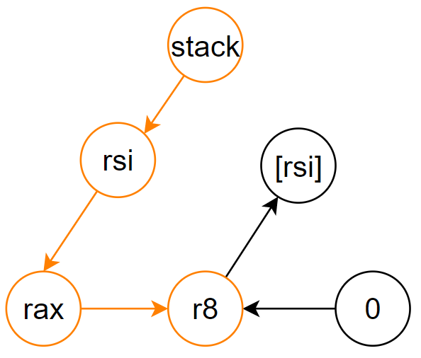
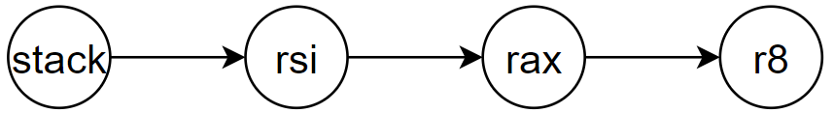
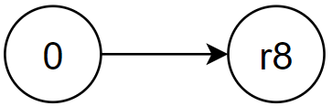
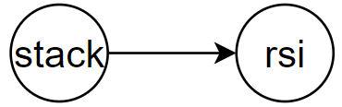
We will encounter some troubles…
Data dependency: a register or memory cell must be set with the desired value.
①
③
④
①
③
④ add r8, rax;
mov qword ptr [rsi], r8;
① pop rsi;
③ mov rax, rsi;
④
Traverse and get only path to set R8 = 3
rsi = ?
rax = rsi
r8 = r8’ + rax
rsi = 3, r8 = 0
SMT Solver
① pop rsi;
② xor r8d, r8d;
③ mov rax, rsi;
Get one path to set R8 = 0
④ add r8, rax;
mov qword ptr [rsi], r8;
Data dependency：r8 = 0
Data dependency：rsi = One Address
① pop rsi;
r8 = r8+3
Get one path to set RSI = One Addr
rsi require address
Notes:
Following those path, we select Gadgets from the corresponding categories and using SMT solver to get a feasible solution, such as setting RSI to 3 and R8 to 0.
Here is the first trouble, the execution of the third Gadget relies two data dependencies: before the execution, R8 must be 0, and RSI must be an address.
This requires us to find new Gadgets to resolve this issue.

Slide 12
We will encounter some troubles…
Data dependency: a register or memory cell must be set with the desired value.
Side effect: a desired context built by an earlier gadget is tampered by a later gadget.
Insert
① pop rsi;
rsi = address
② xor r8d, r8d;
① pop rsi;
Insert
② xor r8d, r8d;
side effect!
① pop rsi;
rsi = 3
① pop rsi;
④ add r8, rax;
mov qword ptr [rsi], r8;
③ mov rax, rsi;
③ mov rax, rsi;
Data dependency
④ add r8, rax;
mov qword ptr [rsi], r8;
Side effect
Identify And Solve Them.
Notes:
If we find Gadgets to resolve and Random insertion at the beginning could lead to new problems.
For example, the instruction 'pop rsi' in the first Gadget sets RSI to a legal address, while the third Gadget overwrites it to 3.
Unfortunately, these data dependencies and side effects cannot be well handled by existing works. And complex Gadgets may have more data dependencies and side effects.

Slide 13
We will encounter some troubles…
Challenges: Find All Gadget Combinations Based on the GCG
How to put all complex gadgets to GCG?
How to reduce the search space of SMT Solver?
How to resolve Data Dependencies and eliminate Side Effects in Gadgets?
①
③
④
①
②
④ add r8, rax;
mov qword ptr [rsi], r8;
① pop rsi;
③ mov rax, rsi;
①
③
④
rsi = ?
rax = rsi
r8 = r8’ + rax
Data dependency
rsi = 3
SMT Solver
Side effect
We Use a Systematic Approach to Address Them!
Notes:
Overall, we face three major challenges:
How to put all complex gadgets to GCG?
How to reduce the search space of SMT Solver?
And How to resolve Data Dependencies and eliminate Side Effects in Gadgets
TGRop introduces a systematic approach to address these issues.

Slide 14
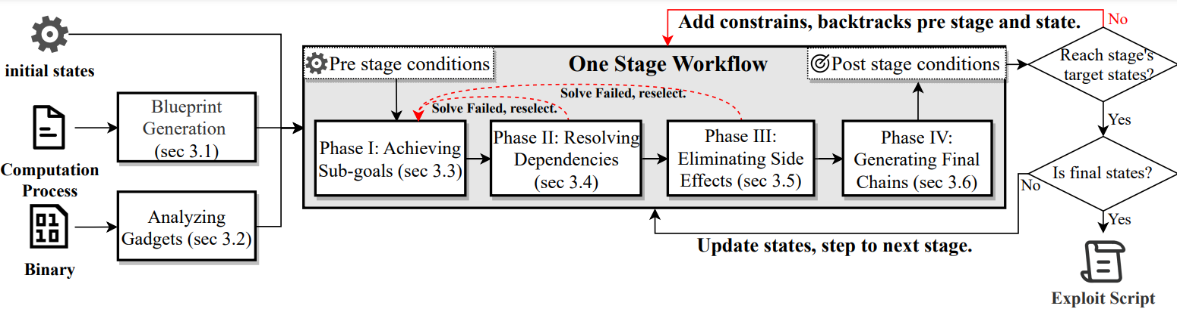
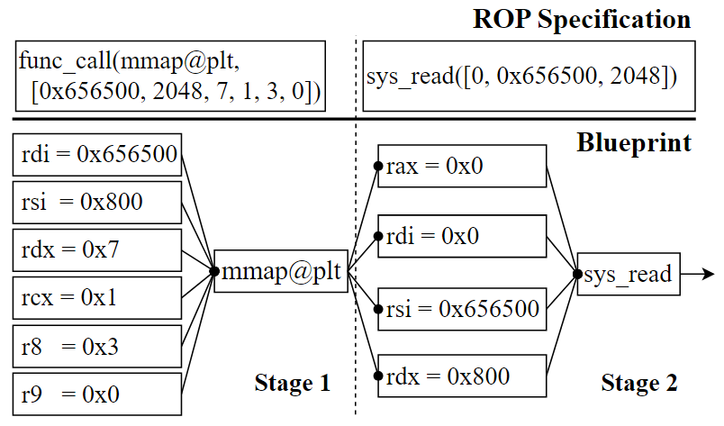
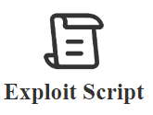
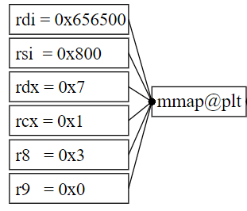
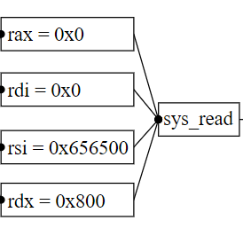

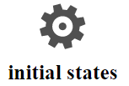

Our Method - Overview
Stage 1: mmap a ‘rwx’ memory region
Stage 2： read shellcode
Exploitation Buleprint Example
Guided by a blueprint, constructs ROP Stage-by-stage
Notes:
This is an overview of TGRop, which acknowledges that ROP exploitation involves multiple stages.
TGRop allows users to describe a complete exploitation process. Then, we generate a blueprint, and our core idea is that, guided by this blueprint, the ROP is constructed stage-by-stage.
For example, the first stage is to mmap a ‘rwx’ memory region, and the second stage is to read shellcode.
The stages of ROP, like Harry Potter and Hermione, combine to form powerful magic.

Slide 15
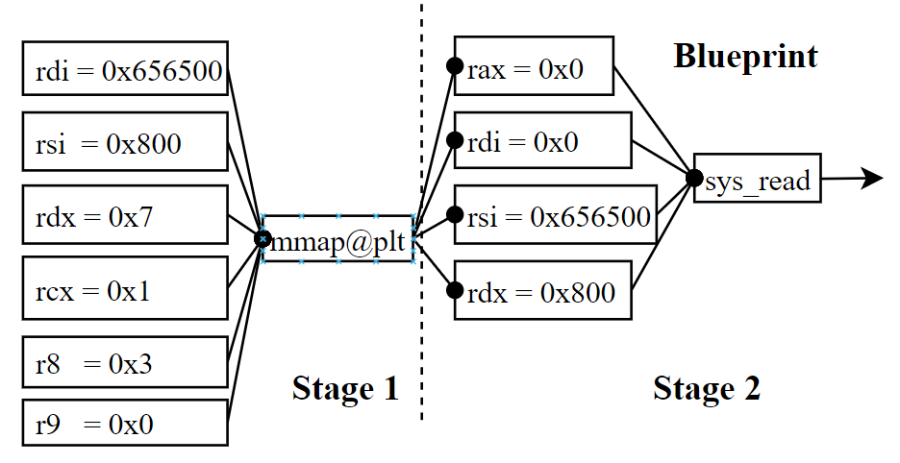
Our Method - Preprocessing
Blueprint Generation
TGRop’s support interfaces
Register write
Memory read
Memory write
Function call
System call
func_call(mmap@plt,
[0x656500, 2048, 7, 1, 3, 0])
Multiple Stages
Sub-goal
Multiple Sub-goals
sys_read([0, 0x656500, 2048])
Stage
ROP Specification
Blueprint Generation
Node: operands; Edge: Data-Flow
Analyzing Gadgets
Symbolic execution identify the semantic
Classification based one semantic
Each semantic has src and dst operand
Src operand can be multiple
Dst is a single operand
Symbolic Representation of Operators
Node: operand
Edge: Data-Flow
Gadget Computation Graph Building
Notes:
Before ROP construction, there is some preparation work.
About the blueprint generation，
TGRop provides five interfaces to easily define the computation process. such as, memory write, function call etc.
We use function calls and system calls as boundaries between stages, while all interfaces contribute to ROP's sub-goals. The combination of these sub-goals can form an exploitation.
Regarding the Gadget analysis phase, we first classify Gadgets into 15 groups.
Then, we use symbolic execution to extract semantic information.
Finally, we construct the Gadget Computation Graph (GCG) based on the semantics of the Gadgets, mapping operands to nodes and marking directed edges as data flows.
This way, we systematically organize all gadgets in the program within the GCG based on the potential data flows they can introduce.
TGRop leverages GCG as the clue to search for the gadget combination.

Slide 16
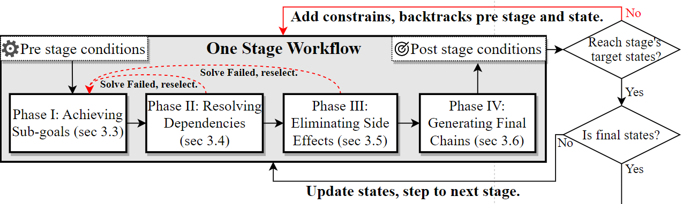

Our Method
Guided by a blueprint, TGRop constructs ROP chains stage-by-stage
Phase I: Achieving Sub-goals
Phase II: Resolving Dependencies
Phase III: Eliminating Side Effects
Phase IV: Generating Final Chains
Each stage completes a function/system call, with independent ROP generation.
No dependencies or side effects between stages
If a stage wins, update states, step to the next stage
If a stage fails, roll back and switch states
Notes:
After preprocessing, we follow the blueprint to construct ROP chains stage-by-stage.
Each stage includes four phases.

Slide 17
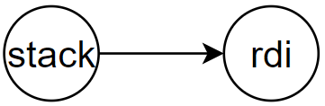
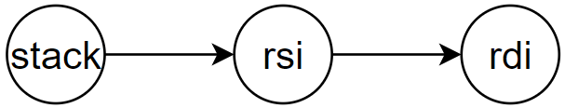
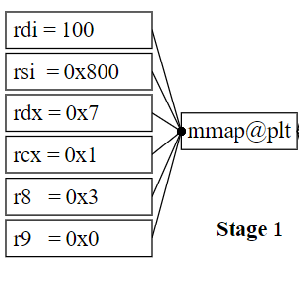


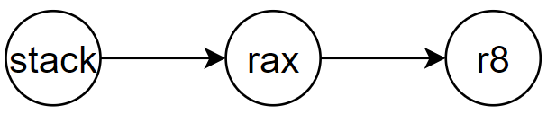
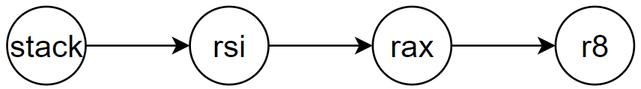

Our Method - Phase I: Achieving Sub-goals
Pre & Post condition
GCG Traverse → Paths
Tentative Chaining
stack → rdi:
pop rdi; ret;
stack → rsi:
Pop rsi; ret;
rsi → rdi:
Mov rdi, rsi; ret;
Pre
rdi = 0x414141
Post
rdi = 100
Tentiative chain by SMT Solver
① pop rdi; ret
① pop rsi; ret; ② mov rdi, rsi; ret;
stack -> rax:
pop rax;
or byte ptr [rax - 0x77], cl;
ret;
rax → r8:
mov r8, rax; jmp r8
mov r8, rax; sar r8, 63; ret
add r8, rax; mov [rsi], r8; pop rbp; ret
Pre
r8 = 0x7fffffffdbc8
Post
r8 = 3
Notes:
In Phase I, we extract each sub-goal from the blueprint, such as setting RDI to 100.
We define the sub-goals as post-conditions, and the initial state as the pre-condition.
Then, we search the GCG to find the gadgets combinations that can achieve the sub-goal. In the Tentative Chaining phase, we use an SMT solver to filter out any gadgets that definitely cannot be used.
A particular case occurs when setting R8 to 3.
Here, we found only two paths that could set R8.
With the SMT solver, we filtered out many Gadgets, leaving us with the only viable combination.

Slide 18
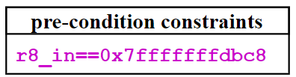
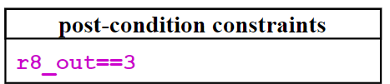
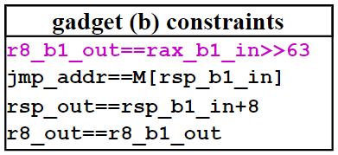
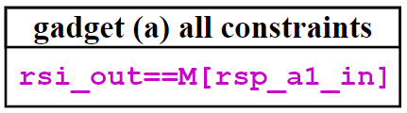
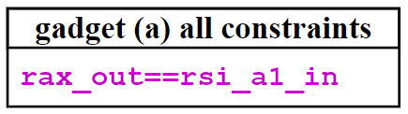
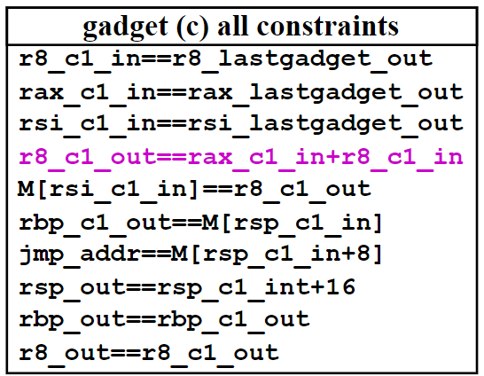
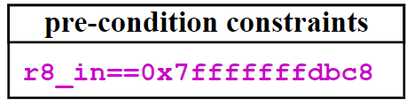
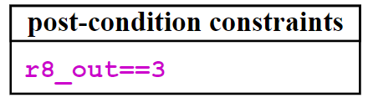
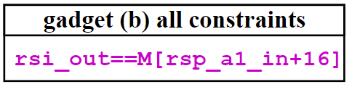
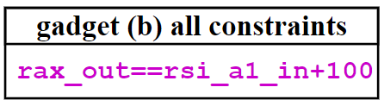
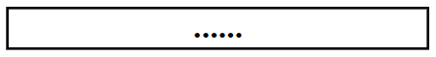
Our Method - Phase I: Achieving Sub-goals
Pre
r8 = 0x7fffffffdbc8
Post
r8 = 3
pop rsi; ret
conflict
SMT Solver
mov rax rsi; ret
r8_out = 0/1
mov r8, rax; sar r8, 63; ret
Tentative Chaining
pop rsi; ret;
mov rax, rsi; ret;
add r8, rax; mov qword ptr [rsi], r8; ret;
SMT Solver
Temporary Feasible Solution Exists
Notes:
More specifically, the SMT solver checks for conflicts in the symbolic semantics of each Gadget during combination.
For instance, this Gadget restricts R8 to only 0 or 1, it conflicts with the sub-goal of setting R8 to 3. Such Gadgets will be discarded.
In the Tentative Chaining phase, we retain only those Gadget combinations that the SMT solver check it with feasible solutions.

Slide 19

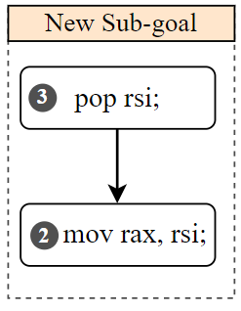

Our Method – Phase II: Resolving Dependencies
Data dependency: a register or memory cell must be set with the desired value.
Valid Address: Requires the valid Address stored in a register
Correct Target: The next instruction to execute is the start of the desired gadget
Suitable Value: The value of a source operand is suitable so that after computation, the value of a destination operand is correct.
mov [rdi], r8
jmp rax
add r8, rax
jmp rax
Data dependency
Phase I + Phase II
New Sub-goal:
rax = next gadget addr
Iteratively Generate Each Sub-goal to Solve Data Dependency
Notes:
In Phase II, we will systematically address data dependency.
Data dependency refers to the situation where a register or memory cell must be set with the desired value.
We categorize these into three types: Valid Address, Correct Target and Suitable Value.
For example, the instruction 'jmp rax' creates a new sub-goal requiring that RAX be set to the address of the next Gadget.
This sub-goal then iteratively undergoes Phase I and Phase II to generate a new ROP.
In summary, TGRop iteratively generates each sub-goal to solve data dependencies, much like finding the right hat for each Lego McGonagall.

Slide 20


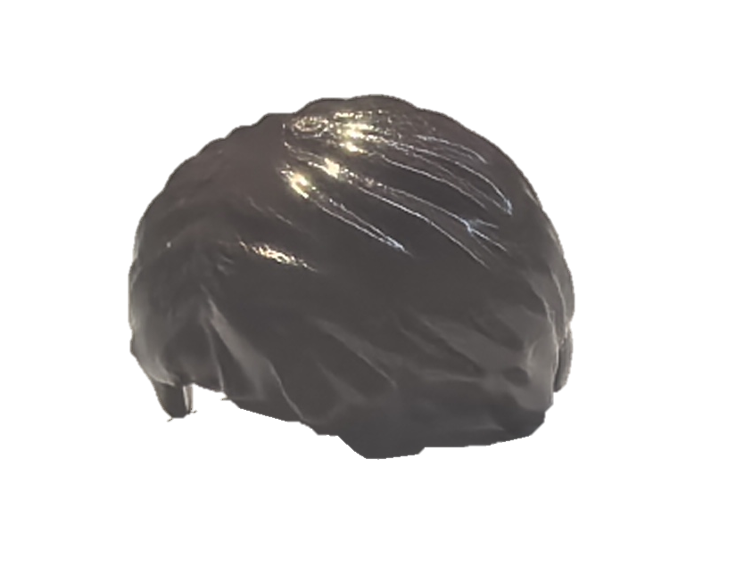
Our Method – Phase III: Eliminating Side-Effects
Side effect: a desired context built by an earlier gadget is tampered by a later gadget.
WIN
Gadget B
Gadget A
Side effect
Gadget A
Gadget B
Focusing on Determining the Execution Order
Notes:
In Phase III, we primarily address the issue of side effects, which occurs when a desired context built by an earlier gadget is tampered with by a later gadget.
For example, with gadgets A and B that have similar semantics—if we execute gadget B first and then gadget A, we can successfully create a perfect Lego McGonagall.
However, if we execute gadget A first and then gadget B, the side effects will result in an incorrect Lego McGonagall.
Therefore, focusing on finding the correct sequence for executing gadgets is key to solving side effect problems.

Slide 21
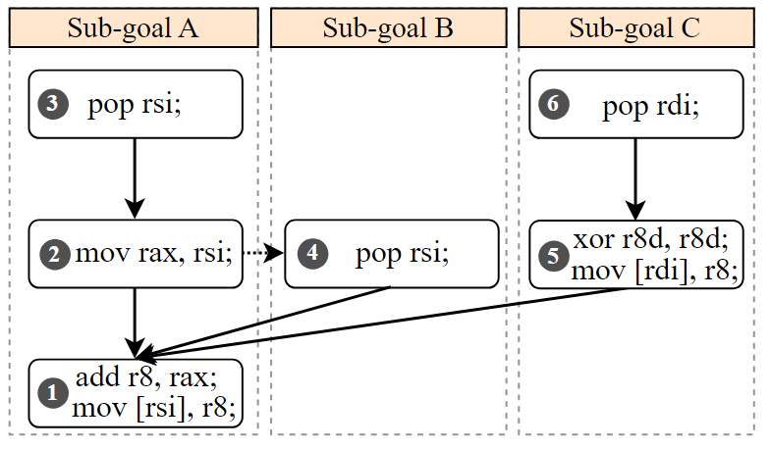
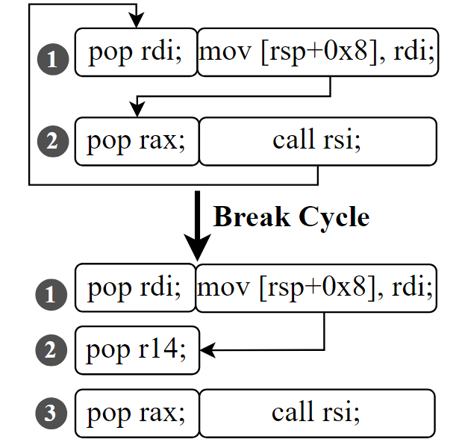
Our Method – Phase III: Eliminating Side-Effects
Side effect: a desired context built by an earlier gadget is tampered by a later gadget.
Build topology to eliminate side effects
Special case: Topology containing cycles.
Topology’s direction:
The desired execution order or write-read/ read-write pair
Special case: Insert a gadget to adjust the stack.
Then, topological sorting can eliminate side effects
Notes:
We construct a topology graph based on the desired execution order and write-read pair during the Gadget combination process.
Through topological sorting, we can achieve the correct execution order.
Additionally, a special case arises when the topology graph contains cycles.
As you show, when two Gadgets interact with the same stack location, creating write-read cycles.
We resolve this by inserting an additional gadget that invokes a pop instruction to adjust the rsp.
As such, the write-read pair is no longer exists, effectively breaking the cycle.
Then, topological sorting can eliminate side effects.

Slide 22
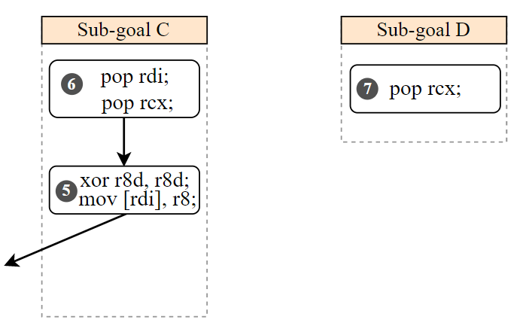
Our Method – Phase IV Generating Final Chains
Choose a better gadget chaining solution
Optimizes the chain by pruning redundant gadgets!
Perform topological sorting and SMT solver to generate gadget chain !
Steps into the next stage, repeating Phases I, II, and III to produce another chain!
Redundant!
Optimizes it!
Notes:
In Phase IV, we will identify any redundant Gadgets that have overlapping other gadget functionalities.
We then optimize these to enhance the quality of the ROP.
By combining topological sorting with SMT solver technology, we generate the final ROP, update the state, and then step to the next stage.

Slide 23
Our Method – Core Implementation
sub-goals
stage
Data dependency
Topology → Side effect
Notes:
This is the core implementation of TGRop.
We break down ROP construction into stages and sub-goals, which helps solve data dependencies and reduces the heavy reliance on SMT solvers.
And the topology helps us avoid side effects.

Slide 24
Evaluation --- Experiment Setup
Baselines: Six open-source SOTA Tools
Hardcode-based approach: Ropper, ROPgadget;
Heuristic-based approach: Angrop, Ropium, Exrop;
Exploratory approach: SGC;
Test suites:
All programs shipped in Debian 10, CentOS 7, and OpenBSD 6.2, from ROP-Benchmark.
Different architectures programs in Firmwares: MIPS, ARM, and PowerPC.
All programs in OpenBSD 6.5 and 50 programs with ROP Mitigations.
ROP Goals:
Goal #1: Get a Shell
Goal #2: Arbitrary Write
Goal #3: Set Three Registers
Goal #4: Set Four Registers
Goal #5: Set Five Registers
Goal #6: Set Six Registers
Others:
Ubuntu 20.04 machine with an Intel i9-10900X 3.70GHz20-core and 128GB RAM.
Tools have one hour for each goal per program.
Notes:
In our evaluation, we compared TGRop with six SOTA tools.
The heuristic-based approaches include Angrop, Ropium, and Exrop,
Our test suite is divided into three parts: one from the ROP-Benchmark, another have various architectures, and a third is relate with ROP mitigation.
We used these tools to generate six ROP goals payloads for these test suites, including goals like getting a shell, within one-hour time limit.

Slide 25

Evaluation - TGRop is outperform SOTA approaches
TGRop is 1.62 to 27 times better.
For goal #1, TGRop Successfully Generates ROP for 97.69% of Programs
At Least a 1.62x Improvement in Success Rate Over Existing SOTA Tools
No False Positives, Only 2 Programs Timed Out (File Size Exceeds 26M)
Notes:
In our first experiment, we generate three ROP goals payloads on a test suites from the ROP-benchmark.
TGRop's performance is the best one.
It successfully generates ROP for over 97% of programs, with improvements ranging from 1.62 to 27 times better than existing tools.
Notably, TGRop achieves this with no false positives and minimal timeouts.

Slide 26


Evaluation - TGRop is outperform SOTA approaches
TGRop also works on multi-arch programs.
Faster and More Accurate Than Humans
Notes:
Additionally, our experiments demonstrated that TGRop performs well across different architectures.
We also conducted human trials, where TGRop outperformed some CTF participants in both the speed and success rate of ROP construction.

Slide 27



Evaluation - Ablation Analysis of TGRop
GCG Helps: TGRop leverages all program gadgets, utilizing 81.66% more gadgets then other tools.
Resolve Dependencies Matters: 64.7% of Programs Have Data Dependency Issues
C: Chain Length K: Candidate Gadgets T: Given Time
Only TGRop Succeeds: 202 of 312 Programs
Exploratory Tools: SGC in different threshold settings
Compared with Exploratory Tools: Heuristic Approaches are More Lightweight
Time is Not the Key; Even with Increased Time, SGC Still Fails in Most Programs.
Longer Chains or More Gadgets Increase Overhead, Easily Leading to SGC Failures or Timeouts.
Notes:
This slide presents an ablation analysis of TGRop.
Our results show that TGRop uses 81% more gadgets than other tools, significantly enhancing its performance.
Moreover, 64% of programs have data dependency issues, which TGRop successfully resolves.
Compared with Exploratory Tools, heuristic approaches are more lightweight.

Slide 28

Evaluation – Has TGRop discovered weaknesses in newest mitigations?
ROP Mitigations
‘RETGUARD’ by OpenBSD: Cut Gadgets by About 76%.
‘-fzero-call-used-regs’ option in GCC: Reduced Gadgets by About 60%.
TGRop Successfully Bypasses These Mechanisms
TGRop uses complex gadgets, like ending in call/jmp/jnz…
For ‘RETGUARD’, TGRop performed well in 185, 231 and 231 programs of each goal.
For ‘GCC fzero’, TGRop succeeds in 92% of cases.
Notes:
This experiment highlights TGRop's ability to bypass certain ROP mitigations, even in the reduction of Gadgets.
However, TGRop demonstrated a high success rate, bypassing these mechanisms in over 92% of cases, showcasting its robust performance against modern security measures.

Slide 29
Conclusion
TGRop is a systematic approach to automating ROP chain construction, overcoming the fundamental limitations of existing works.
TGRop outperforms all open-sourced state-of-the-art tools and demonstrates that its design principles are both rational and efficient.
TGRop has disclosed design weaknesses in the latest ROP mitigations, which have been reported to vendors.
Others Details:
https://sites.google.com/view/tgropsdetails
Notes:
In conclusion, TGRop systematically enhances ROP construction and outperforms existing tools.
It also reveals design weaknesses in recent ROP mitigations.
For further details, please visit our website.

Slide 30
Q&A
TGRop: Top Gun of Return-Oriented Programming Automation
Contact : zhongnanyu@iie.ac.cn
Repo: https://github.com/ZoEplA/TGRop
Notes:
Thank you for your attention. So, any questions.

